Slide 1
Helping people build healthier, happier, and hope-filled tomorrows.

Slide 2
Mission, Vision, and Values
Notes:
Lutheran Services Florida is an organization that has been flexible, insightful, and adaptive through decades of changing political demands and social needs, however, our mission remains unchanged. LSF exists to bring God’s healing, hope, and help to people in need in the name of Jesus. Our business of helping those most in need demands unique skillsets and values. We are open-minded, compassionate, generous, visionary, and honest, and our resolute workforce puts these values on display daily even in the most arduous and heart-breaking of circumstances. Our vision for Florida’s diverse population and their wide-ranging needs is to make children safe, families strong, and communities vibrant, and in order to achieve that vision, we have to become the best place for clients, employees, and investment.

Slide 3
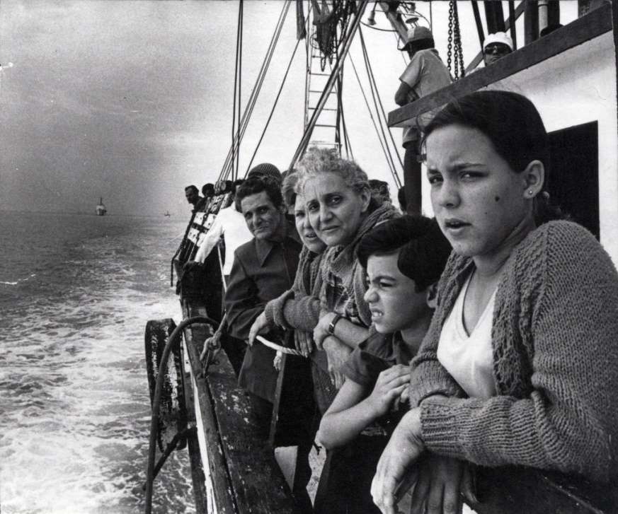
Historical Timeline of LSF
LSF Health
Systems
2012
Major Expansion
For Head Start
Begins
2010
Foster Care
Case Mgmt
2004
1992
Oasis
Youth Shelter
Since 1982, LSF has steadily expanded. While LSF was born out of a refugee crisis, we strive to help every struggling Floridian build healthier, happier, and hope-filled tomorrows.
NW CINS/FINS
& Guardianship
1990
1984
SW & SE
CINS/FINS
Founded 1982
Notes:
Lutheran Services Florida was established in 1982 as a means to sustain the work of Lutheran churches that came together in the 70’s and 80’s to address the Vietnamese and Cuban refugee crises . Since those early years we have taken on a more holistic approach. We seek to achieve a vision of “Safe Children.”, “Strong Families.” and “Vibrant Communities.” with services, partnerships, and advocacy across the state to meet a variety of critical social and psychological needs. Through this expansion of our service model we strive to help every Floridian create healthier, happier, and hope-filled tomorrows.

Slide 4
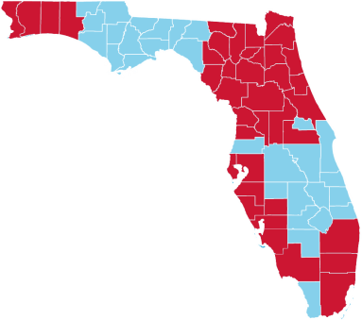
Statewide Expansion
*Red counties host LSF programs
450,000+ served last year… 1 in 50 Floridians!
Over 60 diverse programs managed
Programs cover 60% of the state
1,400 world-class employees
Notes:
LSF’s has expanded to 38 counties across the state to meet increasingly diverse needs.
We now serve almost a half million people with over 60 social service programs.
Our 1,400 professionals address community needs in about 60% of the state today.

Slide 5
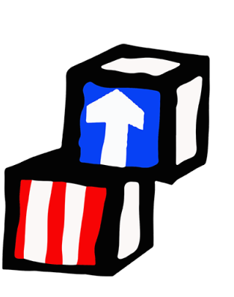
Early Childhood Education & Development
NURTURING AND DEVELOPING INFANTS & CHILDREN
Every child deserves the best start she or he can have, no matter their circumstances. LSF’s Head Start is a Super Grantee entrusted with developing thousands of young lives across a spectrum of service areas intended to educate, edify, strengthen children and their families.
HEAD START
EARLY HEAD START
CHILD CARE FOOD PROGRAM
Notes:
Operating in 4 of the states largest counties and considered a federal “Super-Grantee”, LSF Head Start & Early Head Start programs:
Serve over 7,500 children, most of whom will be entering Kindergarten ahead of their peers with 1st grade or better reading and math skills.
Also, our Child Care Food Program served almost 2.5 million meals last year to over 4,200 children across Florida.

Slide 6
Substance Abuse and Mental Health
Providing the right service, at the right time, and in the right setting
LSF Health Systems is one of seven behavioral health Managing Entities (ME) contracted by the Florida Department of Children and Families to manage the state-funded system of behavioral health care for people who face poverty and are without insurance.
MANAGING ENTITY
TRAINING INSTITUTE
DISASTER RESPONSE INITIATIVES
Notes:
LSF Health Systems serves a 23-county region in Northeast and North Central Florida.
LSF Health trains over 2,300 health care workers yearly;
Manages mental health services for 76,000 patients;
And connects almost 300,000 Floridians to substance abuse and mental health resources in their communities.

Slide 7
Adult & Elder Services
PROTECTING AND CARING FOR At-RISK Adults
As part of our mission to help individuals build healthier, happier, and hope-filled tomorrows, LSF graciously works alongside those who may be forgotten or may feel hopeless, which often occurs with the elderly, disabled, or those suffering from a chronic illness.
GUARDIANSHIP
HIV/AIDS CARE & EDUCATION
HUMAN TRAFFICKING ASSISTANCE PROGRAM
Notes:
Adding to LSF’s holistic approach to “Safe Children.”, “Strong Families.”, and “Vibrant Communities.”, LSF has programs focused on adult and elderly populations facing adversity related to health, aging, and Human Trafficking. Through our programs, LSF has:
Protected over 400 vulnerable people via guardianship services;
Facilitated AIDS care and education for over 250 clients;
And ensured safe and secure housing was obtained for over 500 clients.
Additionally, LSF has been helping victims of Human Trafficking for many years and just secured a federal grant for the “Look Beneath the Surface Regional Anti-Trafficking Program”, which helps raise public awareness on identifying and reporting trafficking activities.

Slide 8
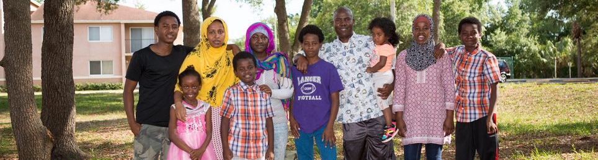
Immigration & Refugee Services
WELCOMING REFUGEES AND IMMIGRANTS
Through our refugee resettlement and immigration services, Lutheran Services Florida is privileged to be on the front lines of assisting refugees to their new homes and creating a welcoming environment to the immigrant communities that arrive at our doorstep seeking a brighter future.
IMMIGRATION SERVICES
EMPLOYMENT & SELF-SUFFICIENCY
REFUGEE RESETTLEMENT ASSISTANCE
Notes:
Our foundational programs in Refugee and Immigration Services helped more than 600 refugee families resettle last year;
We accommodated the immigration needs for over 15,000 individuals;
And helped over 13,000 people understand the nuances of the American job market and find adequate employment.
Naples Immigration Story
Between 2010-2015 more than 140,000 refugees, asylees, and Certified Victims of Human Trafficking arrived in Florida, with many going to areas that had little to no support to help them gain self-sufficiency. LSF opened offices in several areas in need of resettlement support, including Naples, Fort Myers, and Sarasota. This expansion, funded in large part by a Department of Children and Families grant, will help newly arrived families assimilate to American culture and become productive citizens that contribute to the vibrancy of communities like yours.
Take the story David Montero for example. David, a Cuban refugee, entered the United States on March 12, 2016 through the port of El Paso with his wife and infant child. In Cuba, David was a journalist and activist. Because his words went against the Castro-run government, David was tried, convicted and sentenced to 10 years in Cuban prison. After his release, he and his wife sought refuge in the United States, a stout protector of free speech.
When David came to LSF, he was very eager to start working. His case coordinator told him that he couldn’t work until he received his EAD, or (Employment Authorization Document. In the meantime, he was encouraged to take ESOL classes and learn as much English as he could. David signed up for classes at Cypress Lake High School. David also attended the English Café at the library so that he could improve his conversational English.
In August, David received his EAD, then took advantage of our Work Readiness and Vocational English classes. While in sessions with his Employment Counselor, David’s motto was always, “I will do any work. I want to work. I need to work.” Knowing that he came from a professional background, the Employment Counselor was hesitant to send David on interviews that involved manual labor. David didn’t mind. In fact, he was excited.
David was soon hired at a company called Protective Barriers. This was not work he was accustomed to, but David NEVER complained. He goes to work every day. He arrives to work early and stays late when needed. When the Employment Counselor checked on his 90-day with the company, David got nothing but rave reviews.
David is a volunteer at his church, Centro Internacional De Avivamineto. He and his family lived in a room provided to them by a church friend, but had a hard time fitting their entire life in one room. After Christmas that year, David found an apartment. Scarcely furnished, he found some furnishings at yard sales or set out on trash day. Though they don’t have very many possessions, David and his family have something that he longed for while he sat in a Cuban prison…..FREEDOM.
David, like other refugees looking for a new start, came to us with zest, passion and drive. He embraced his new country and everything about it. He wants to try new things and go to new places. He is an active resettlement program participant who never missed an appointment and provided everything we asked. David is that LSF client that makes our staff do the “Happy Dance” and is now an key contributor to the vibrancy of his community.

Slide 9
Child Welfare
PROVIDING SAFE SPACES FOR YOUTH IN CRISIS
Lutheran Services Florida (LSF) offers a range of child welfare services with the overall mission of ensuring the safety and security of children, and strengthening and preserving families when possible.
YOUTH SHELTERS
COUNSELING SERVICES
CHILD WELFARE CASE MANAGEMENT
Notes:
Last year we provided 30,000 individuals with referrals to critically needed services;
2,000 kids in the foster care systems were provided LSF case management services;
1,100 received crisis counseling;
And 700 youth found refuge and direction at one of our four Safe Place shelters
Fort Myers CINS/FINS Story
Approximately 20 percent of children living in the United States are victims of sexual abuse: innocent kids like Julie, whose life was shattered when she was 5 years old.
Julie was sexually abused by her grandfather when she was only 5 years old. His threats of harm kept her silent about her abuse until middle school, when she finally told her teacher. She was admitted to therapy, but the trauma of her experience was so extreme that she could not complete the process. Her school performance declined, and she began misbehaving and fighting constantly with her parents. Eventually, she turned to drugs and cutting herself to cope with the pain.
Julie experienced something no child should ever endure.
While Julie’s life spiraled out of control, her mother understood her daughter’s pain all too well. She, too, had been abused by the same man. Due to the paralyzing effect of her own scars, Julie's mother remained helpless to intervene. By the time Julie reached high school, her parents feared she would either overdose on drugs or kill herself the next time she turned to cutting.
In desperation, Julie’s mother took her to LSF’s specialized Sexual/Physical Abuse Treatment Program. There, Julie found support among a group of girls with similar stories of abuse, and she finally began to heal. After some time in treatment, Julie found new life. She began sleeping soundly at night, her grades improved dramatically, she built healthy friendships at school, and she discovered a new love of art.
As Julie experienced healing from her pain, Julie’s mother found her own support in the non-offending caregiver groups. She realized that her own history of abuse had impacted her ability to protect her child. Through specialized treatment, she found healing for herself, as well as the strength to better love and protect her child in the future.
Julie was robbed of her innocence and it nearly destroyed her life. But thanks to the support of friends like you, she found healing through LSF’s specialized Sexual/Physical Abuse Treatment Program.

Slide 10
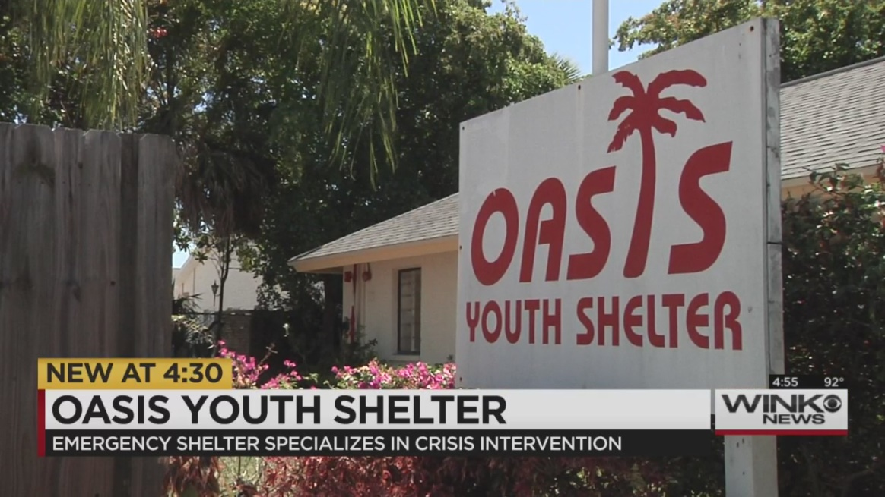
LSF in the News
Notes:
(Counter clockwise)
LSFHS on the frontline’s in Northeast Florida battling the Opioid Epidemic
Recently, a LSF foster family made the heartfelt gesture of adopting their foster child just before her 18th birthday, ensuring she would never again be without a family. The story was featured on Fox 13 News.
LSF helping Hurricane Maria evacuees across the state. In the Tampa Bay area, LSF Head Start, immigration services, and charter school affiliates are stepping up to help.
16-year-old changes life around Oasis Youth Shelter in Fort Myers:
FORT MYERS, Fla.- “I never thought I’d make it this far. Thought I’d lose it along the line.”
For the last two months, 16-year-old Noah Powers has been living at the Oasis Youth Shelter.
It’s a temporary, emergency shelter, run by Lutheran Services, for kids 10 to 17 years old. “They are truant, they can be ungovernable, not following rules at home, runaways, homeless,” said Shelia Dixon, a counselor at the shelter.
Powers was sent to the shelter, because he refused to go to school, among other problems.
“Substance abuse issues. He was staying in a van at his grand mom’s home, because he wouldn’t follow the rules at home,” said Patricia Gaudette, another counselor.
Counselors tells WINK News, they have a short amount of time, to get as much info as they can about all the kids who come in.
“There is always history involved and we have to get to the root of the cause of what’s happening,” said Gaudette.
The staff works to provide kids, and their families, with the right skills.
For Powers, that involved a lot of counseling alongside his father.
“I learned how to communicate better. That’s been something, be in touch with my feelings and communicate,” said Powers’ father, Roger.
“I’ve gotten out of it, it’s not really worth giving up on everything,” said Powers.
During their stay, the shelter works hard to make kids are comfortable.
“Get up, do hygiene, eat breakfast, do chores, go to school. Come home, get tutors twice a week,” said one of the counselors.
Powers got better at basketball and started attending Next Level Church.
He’s also attending classes to make up for the school he missed, and hopes to get back into public school next year.
“School is very important, and family is more important,” said Powers.
His father says “if you give up, you can’t grow up. We’re all becoming better persons for each other.”

Slide 11
Notes:
Lutheran Services Florida is a leading, life-changing human services organization working to transform the lives of people regardless of age, background, or belief. We generously serve children and families, youth and teens, adults and elderly, refugees and immigrants, and victims of natural disasters through various programs ranging from substance abuse and mental health to education. By helping Floridians build healthier, happier, and hope-filled tomorrows, we can advance an aggressive vision of “Safe Children.”, “Strong Families.”, and “Vibrant Communities.” To learn more about our work or how you can partner with us, check out our website at lsfnet.org.

